Slide 1
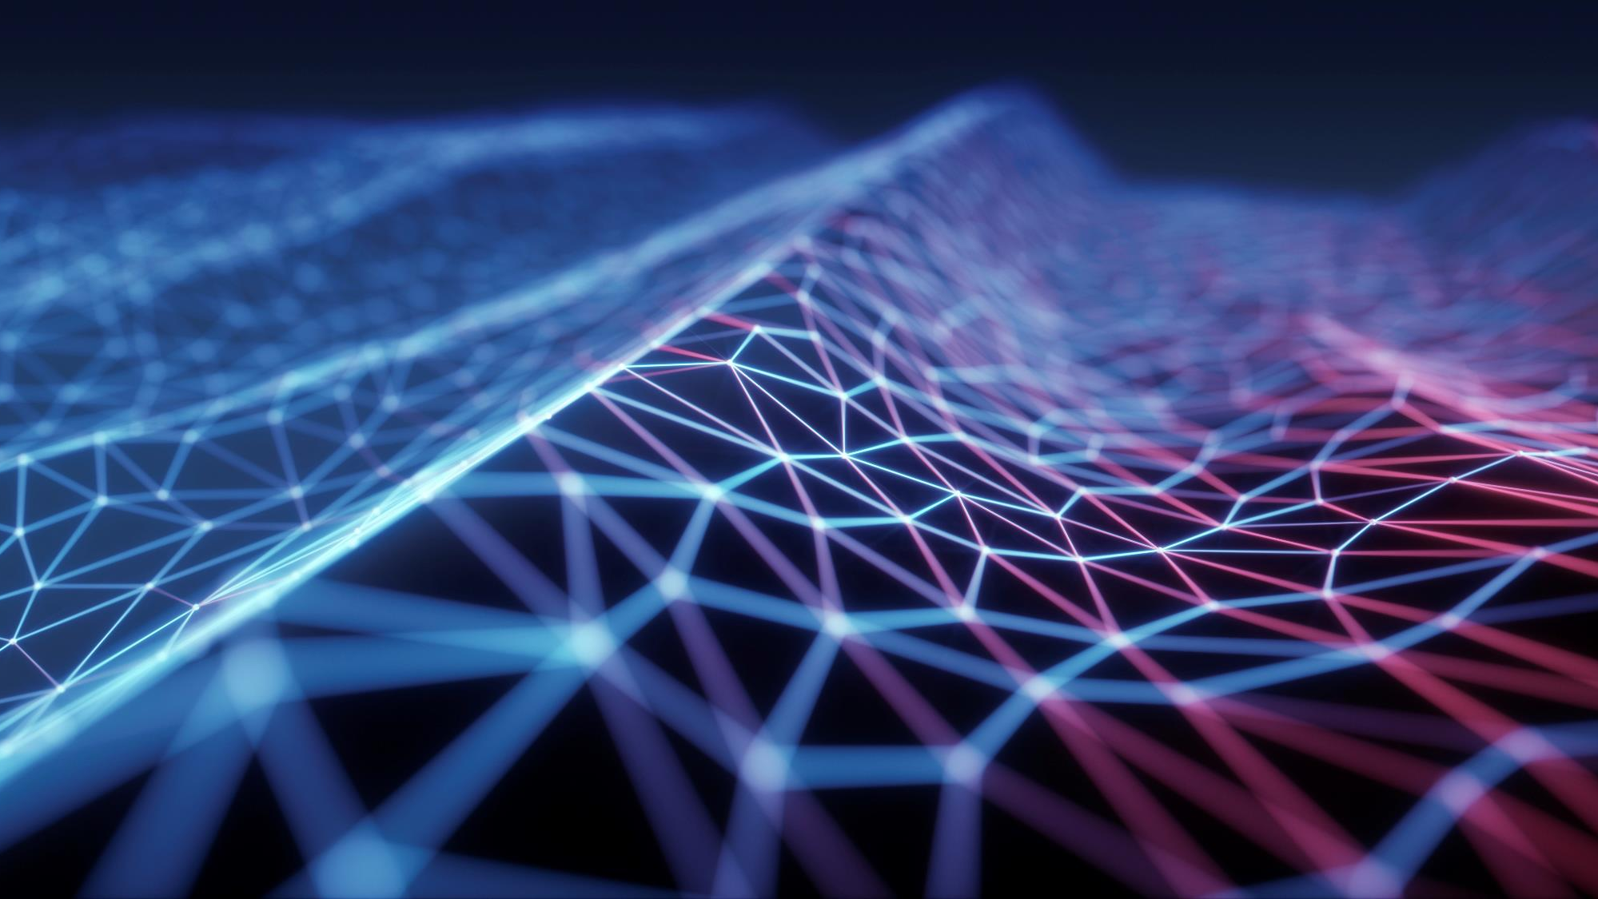
Indoor navigation application
Its importance, the good and the limitation.

Slide 2
INTRODUCTION: INDOOR NAVIGATION
GPS based system of navigation or finding a location on the outdoor premise is a very famous and useful innovation of the 21st century.
For example, the GPS can help a user to find a building and its entrance from hundred miles away but cannot find the meeting room inside the building (Shu, 2015).
Notes:
GPS based system of navigation or finding a location on the outdoor premise is a very famous and useful innovation of the 21st century. However, there is a limitation to its usage. It provides navigation to the accurate location of fixed objects, paths, giving wide range of information to the user. But, there is a problem of the absence of micro-map information because of which navigation cannot be always successful, specifically in the last part of the trip. This is called the last-mile navigation problem.

Slide 3
Why not gps?
For Outdoor application only
Gps can work with Satellites only
Last mile navigation problem
Notes:
It can only be used outside because it requires satellite signals to perform i.e. to find malls, restaurants, schools, hospitals, which requires a swift and easy way to reach in case of emergency. Finding an exact location inside a big university or a large park or even finding a specific position in Disney land can be very difficult and problematic. For indoor navigation, different sorts of sensors have been developed. It includes ultrasonic, magnetic, radio and infrared sensors. The main drawback they all have is that they require electronic infrastructure to calculate measurements and restricted objects require special actuators and sensors. Deployment in of electrical wiring, power consumption, safety, and overall infrastructure requires money and time.
Meanwhile, another promising new technology called Mobile location-based services (LBS), because of its potential use in personalized services. It is also very popular because it is compatible with mobile phones, laptops, tablets, and wearable devices that means it could be used with any of it (Li, 2015). There are many alternative ways to utilize LBS technology. It has been divided into 8 service categories; navigation, local information, networking, fitness, recreational activity, entertainment, family and person locator (BergInsight, 2014).

Slide 4
Need for lbs
Personalized services
Compatible
local information
Navigation
Networking
Fitness
recreational activities
For blind people
Notes:
another promising new technology called Mobile location-based services (LBS), because of its potential use in personalized services. It is also very popular because it is compatible with mobile phones, laptops, tablets, and wearable devices that means it could be used with any of it

Slide 5
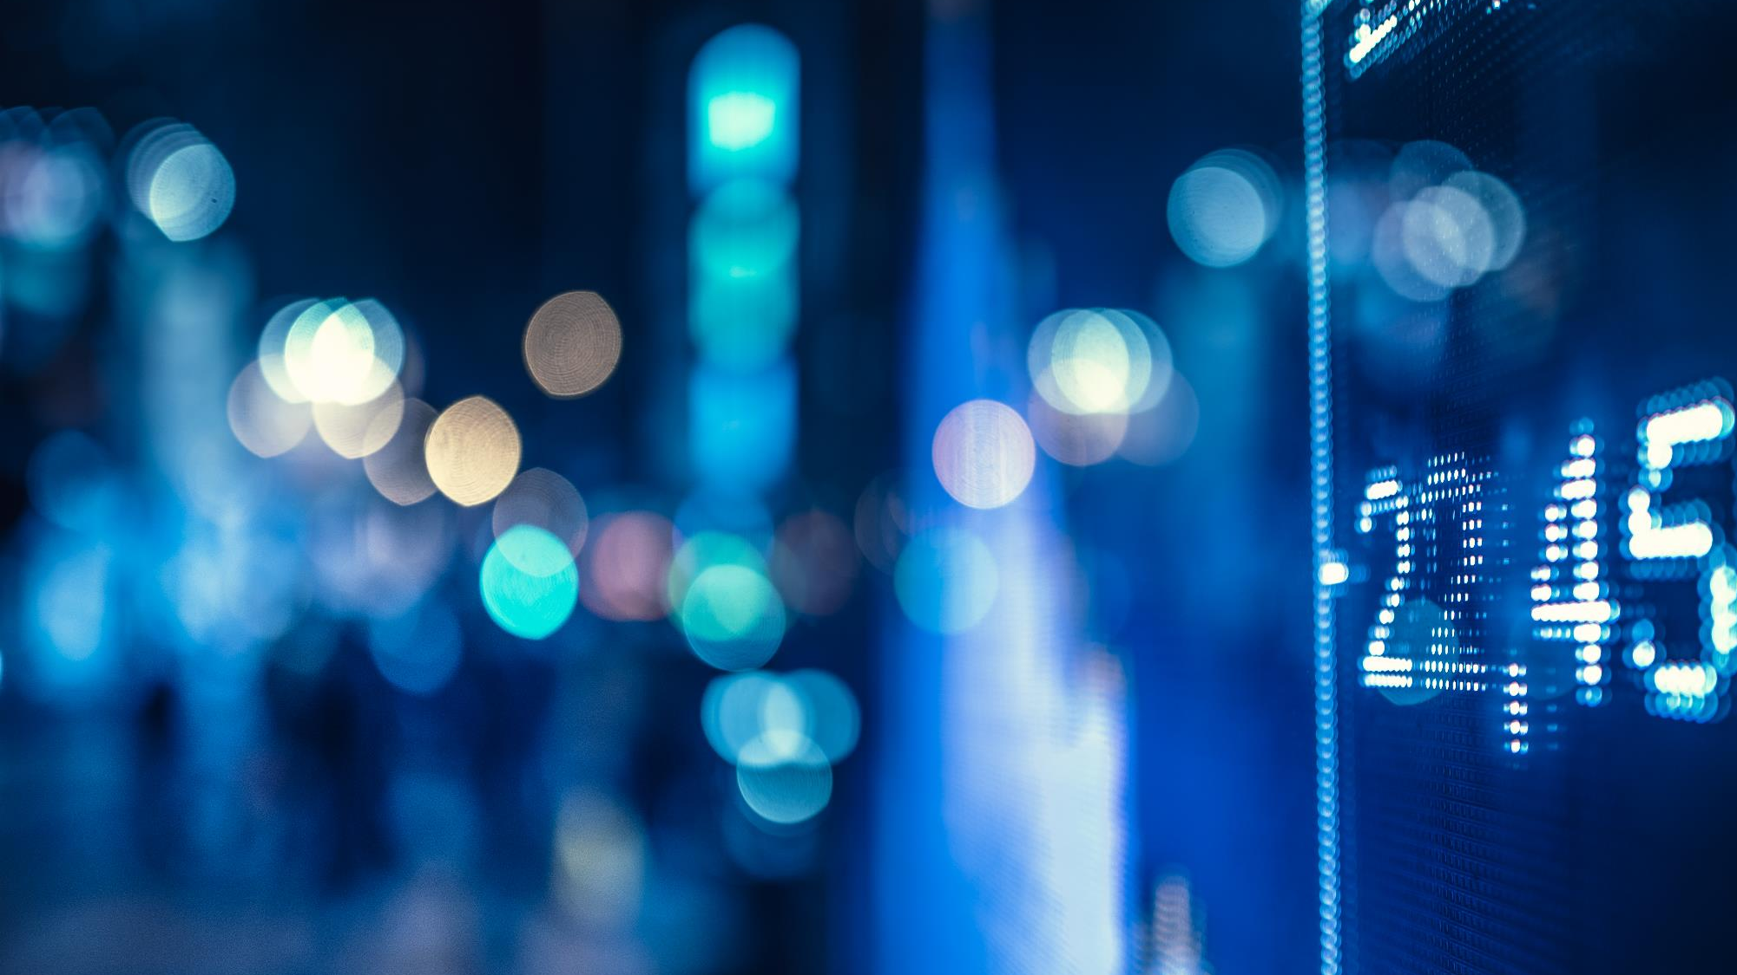
SUCCESSFUL POSITIONING SYSTEMS
SmartCampusAAU
Micello
Android Mobile Navigation System (AMNS)
Notes:
Android Mobile Navigation System (AMNS) are used with the help of Quick Response (QR) codes. The geographical measurements are stored inside QR codes. The codes are detected when position analysis on the application is used. AMNS is very easy and accessible. It incorporates GPS as well as QR codes which help in finding nearby spots or people (Yayan, 2014).
SmartCampusAAU, uses Dijkstra the algorithm helps to find the shortest distance to the specific required target position. It is compatible with all major software and mobile platforms that include Android, Windows phone as well as iPhones.it requires Radio signals which initiate from the fixed source locations to the positioning.
Another indoor navigation, Micello, which uses Point of Interest (POI) for navigation. It can be used on IOS and Android platforms. It requires manual input of the starting point and final destination in order to generate a path. It uses NFC technology and QR codes in order to find the current application.

Slide 6
SUCCESSFUL POSITIONING SYSTEMS
Micello
MazeMap
Notes:
MazeMap is another indoor map application. It can be used on PC and mobile phones. It facilitates the user to get a shortest path to its desired final location. It can find nearest toilet, class, department etc. But it can only work if you are online.
Bluenion, is another positioning application that can be used inside the building. It is exclusively designed to be used inside buildings, hospitals, museums, shopping malls and airports. Other than that, it can also help visitors or tourist to find services, entertainment, products or any person or thing. It can be used by using a beautiful bracelet.

Slide 7
The good
Target location
Faster and efficient
Waste time
Wide range of platforms
Versatility
Beneficial for blind people
Notes:
Indoor navigation comes into play when a person/user is on the target location and wants to find further. Perhaps new book, shoes, sale items, coupons, or simply sightseeing. It helps them to reach at the area directly. It is faster and efficient as compared to the outdoor navigation because covers relatively smaller area (Mendelson, 2014).
It helps the tourist and the visitors who are at the particular place for the first time and do not want to waste their seconds. It solves issue related to routes and unnecessary hassle of asking others. Indoor navigation systems are compatible with wide range of platforms. Versatility such as this allows a user to benefit from it all the time.
Most importantly, it is mainly beneficial for blind people. They want to know about the place they are in and the objects around them. This technology is beneficial in for people who want to reach a certain position, know about dangerous position, distance and appropriate path (Padøy-Wold, 2017).

Slide 8
The limitations
Limited area coverage
Breaching of privacy
Notes:
On the other hand, it is more challenging to map and pave a way. For example, the positions of two locations must not be greater than 10 meters. The stores, the aisles, the products must be 10 or less meters apart (Mendelson, 2014).
Internet of things, IOT, aims at connecting anything with anything or anyone at any time. With GPS and LBS, all things are connected with one another through wireless, invisible threads which facilitates the user but can be easily breached. One of the biggest disadvantage of using LBS is the unwanted, unwarranted, and non-consensual invasion of privacy. In LBS, user get many benefits but at the cost of his personal data and privacy. Some sensitive information, like current location, future location, surroundings are visible to untrusted LBS provider. It could result in the use of private information directly or releasing to the third party for any potential gain. But this is being controlled by new researches and ideas which involves creating anonymity, creating noise or shifting the original current location (Niu, 2015).

Slide 9
CONCLUSION
There are a lots of innovations and developments with varying advantages and disadvantages. Technologist are working to minimize the drawbacks and deficit.
The demand for the precise and accurate, both indoor and outdoor, locations is increasing.
Notes:
Science and technology are considered to be most beneficial and invaluable asset of human kind. There are a lots of innovations and developments with varying advantages and disadvantages. Technologist are working to minimize the drawbacks and deficit. The brief discussion of the positioning systems that have been developed already shows that there are no universally accepted, perfect systems. The demand for the precise and accurate, both indoor and outdoor, locations is increasing. Therefor is it mandatory to reduce the potential hazards that this technology has, in order it to be more effective, friendly and safe.

Slide 10
REFERENCES
Shu, Y., Shin, K. G., He, T., & Chen, J. (2015, September). Last-mile navigation using smartphones. In Proceedings of the 21st Annual International Conference on Mobile Computing and Networking (pp. 512-524). ACM.
.
Shu, Y., Shin, K. G., He, T., & Chen, J. (2015, September). Last-mile navigation using smartphones.
In Proceedings of the 21st Annual International Conference on Mobile Computing and Networking (pp. 512-524). ACM.
Li, Y., Zhang, P., Niu, X., Zhuang, Y., Lan, H., & El-Sheimy, N. (2015, October).
Real-time indoor navigation using smartphone sensors.
In 2015 International Conference on Indoor Positioning and Indoor Navigation (IPIN) (pp. 1-10). IEEE.
Yayan, U., Akar, B., Inan, F., & Yazici, A. (2014, June).
Development of indoor navigation software for intelligent wheelchair.
In 2014 IEEE International Symposium on Innovations in Intelligent Systems and Applications
(INISTA) Proceedings (pp. 325-329). IEEE.
Wold, E. Z., & Padoy, S. H. (2016).
Indoor Navigation for the Visually Impaired-A Systematic Literature Review.
Faculty of Information Technology, Mathematics and Electrical Engineering,
Norwegian University of Science and Technology, Norway.

Slide 11
Thank you!

